Slide 1
Denominations and the Missional Church - UK Perspectives
+Graham Cray
Fresh Expressions
1

Slide 2
Today, Fresh Expressions is “no longer any kind of marginal or spare time interest for the Church of England. In recent years, it has become more and more part of what we take for granted as a way of moving forward and growing as a body of Christ.” ++Rowan Williams
Fresh Expressions
1

Slide 3
CRITICAL FACTORS
New imagination about the church
New climate of permission
New resources

Slide 4
A Tale Of Two Reports

Slide 5
MISSION SHAPED CHURCH
‘church planting and fresh expressions of church in a changing context.’
General Synod
Feb. 2004

Slide 6
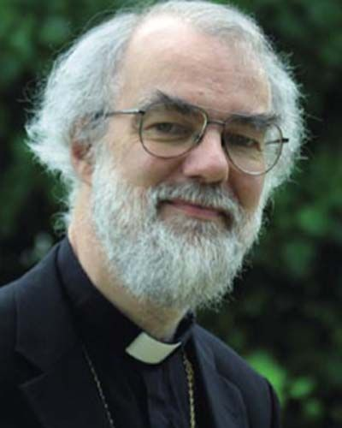
ARCHBISHOP ROWAN
MSC
Mission-Shaped Church
+ ABC
Archbishop of Canterbury
= FEI
Fresh Expressions Initiative

Slide 7
The vital importance of advocacy and diplomacy

Slide 8
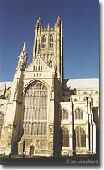
The mixed economy
Celebrating and building on what is mission-shaped in traditional forms of church…
…and finding new, flexible, appropriate ways to proclaim the Gospel afresh to those who do not relate to traditional ways
Notes:
What Archbishop Rowan calls the ‘mixed economy’ church –
A mutually beneficial partnership.
‘Working together creatively in partnership is indeed the most promising mission strategy.’ ++Rowan G Synod

Slide 9
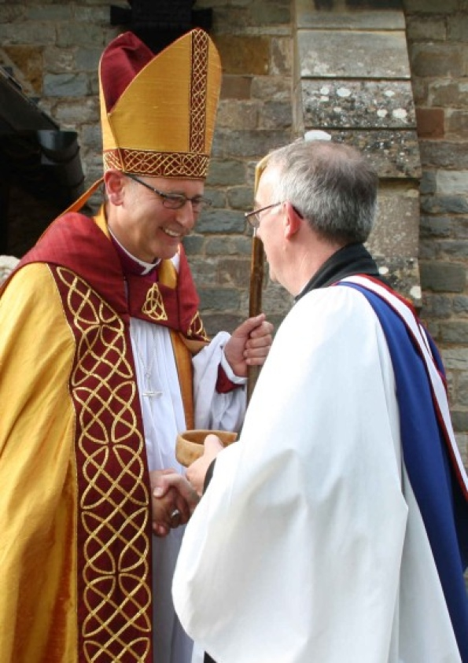
The new rooted in core values
‘Receive the cure of souls which is both mine and yours; in the name of the Father, and of the Son, and of the Holy. Spirit. Amen.’
Fresh Expressions
3

Slide 10
The Declaration of Assent
‘The Church of England ... professes the faith uniquely revealed in the Holy Scriptures and set forth in the catholic creeds,
‘Which faith the Church is called upon to proclaim afresh in each generation.’
‘Bringing the grace and truth of Christ to this generation.’

Slide 11
Connecting the centre to the edge

Slide 12
TEN YEARS PROGRESS
Creation of national ecumenical Fresh Expressions Team

Slide 13
Partners
Edinburgh
Notes:
Today we celebrate Cof S becoming full partners recognising that they have been very active since the early days of the team.

Slide 14
The New Ecumenism
Unity grows as we partner one another in mission!
Fresh Expressions
7

Slide 15
TEN YEARS PROGRESS
Creation of national ecumenical Fresh Expressions Team
Mission Agencies (CMS and Church Army) refocus around this work
Training courses offered across the UK

Slide 16
training
www.freshexpressions.org.uk/missionshapedministry
www.freshexpressions.org.uk/missionshapedintro
Notes:
For those places where they are getting serious and now need to train potential and actual leaders this one year part-time training course is for them: mission shaped ministry (msm).
msm is for individuals and teams who are beginning fresh expressions of church. It is normally taught over three Saturdays, eight evenings and a residential weekend across a year – so it’s not too much for people to fit in alongside work and ministry.
msm is suitable for lay people and for ministers who have not been trained in forming fresh expressions of church. It will lay a good foundation in planting and sustaining new Christian communities.
Many Church Councils and some dioceses, districts and synods are paying all or part of the cost of people attending as
part of their support for fresh expressions of church. Mention if it is available locally adding local contact on the slide.
It’s a very practical course and a lot of the learning takes place through small groups, and through coaching and encouragement between the sessions. The handouts provide you with lots of material for reflection and practical ideas for your fresh expression.
There is almost certainly a course within an hour’s drive of where you live. For more details go to
www.freshexpressions.org.uk/missionshapedministry.
The course covers areas such as: listening for mission, forming community, building vision and values, understanding God’s mission, forming teams, engaging with your community, evangelism, worship and discipleship.

Slide 17
The importance of stories
resources

Slide 18
TEN YEARS PROGRESS
Creation of national ecumenical Fresh Expressions Team
Mission Agencies (CMS and Church Army) refocus around this work
Training courses offered across the UK
Ordained Pioneer Ministers (OPM)

Slide 19
Ordination Selection Criteria Revised
‘Ministers in the Church of England must pursue their vocation increasingly aware of the missionary context in which the church is set.
In previous generations ministry was exercised in a culture where Christian beliefs and behaviours were the norm: today’s context is more of a spiritual and moral market place.’

Slide 20
TEN YEARS PROGRESS
Creation of national ecumenical Fresh Expressions Team
Mission Agencies (CMS and Church Army) refocus around this work
Training courses offered across the UK (msm)
Ordained Pioneer Ministers (OPM)
New legal Framework for network church plants: ‘Bishop’s Mission Order’

Slide 21
Bishops’ Mission Orders
Notes:
Bishops’ Mission Orders
Background
This presentation was developed by Paul Bayes and Steven Croft to introduce the concept of Bishop’s Mission Orders at a series of national training days. We are making the presentation more widely available for use in dioceses, deaneries and parishes to support the roll out of BMOs across the country.
The presentation is designed for use with the booklet: Bishops’ Mission Orders a beginners guide (CHP, 2008). The presenter should have read and digested this booklet thoroughly before using the presentation. Ideally you should obtain a copy of the booklet for every member of the group.
Depending on the group you will need to set as a background to the presentation:
an understanding of the need for fresh expressions of church within a mixed economy church;
some case studies of fresh expressions of church which are either local stories or presentations from expressions: the dvd – 1: stories of church for a changing culture or expressions: the dvd – 2: changing church in every place.

Slide 22
TEN YEARS PROGRESS
Creation of national ecumenical Fresh Expressions Team
Mission Agencies (CMS and Church Army) refocus around this work
Training courses offered across the UK
Ordained Pioneer Ministers (OPM)
New legal Framework for network church plants: ‘Bishop’s Mission Order’
Unanimous reaffirmation by General Synod 6 and 8 years on

Slide 23
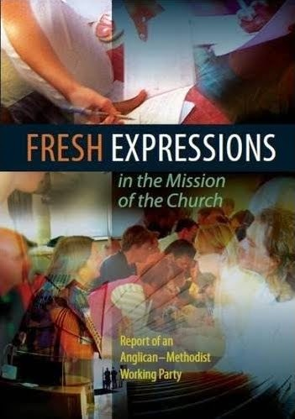
Anglican Methodist Faith & Order Report 2012

Slide 24
TEN YEARS PROGRESS
Creation of national ecumenical Fresh Expressions Team
Mission Agencies (CMS and Church Army) refocus around this work
Training courses offered across the UK (msm)
Ordained Pioneer Ministers (OPM)
New legal Framework for network church plants: ‘Bishop’s Mission Order’
Unanimous reaffirmation by General Synod 6 and 8 years on
Detailed research results

Slide 25
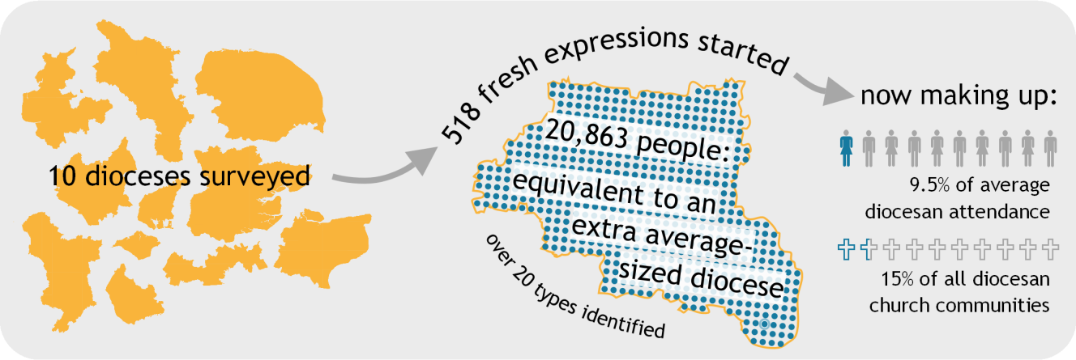
fresh expressions in the Church of England

Slide 26
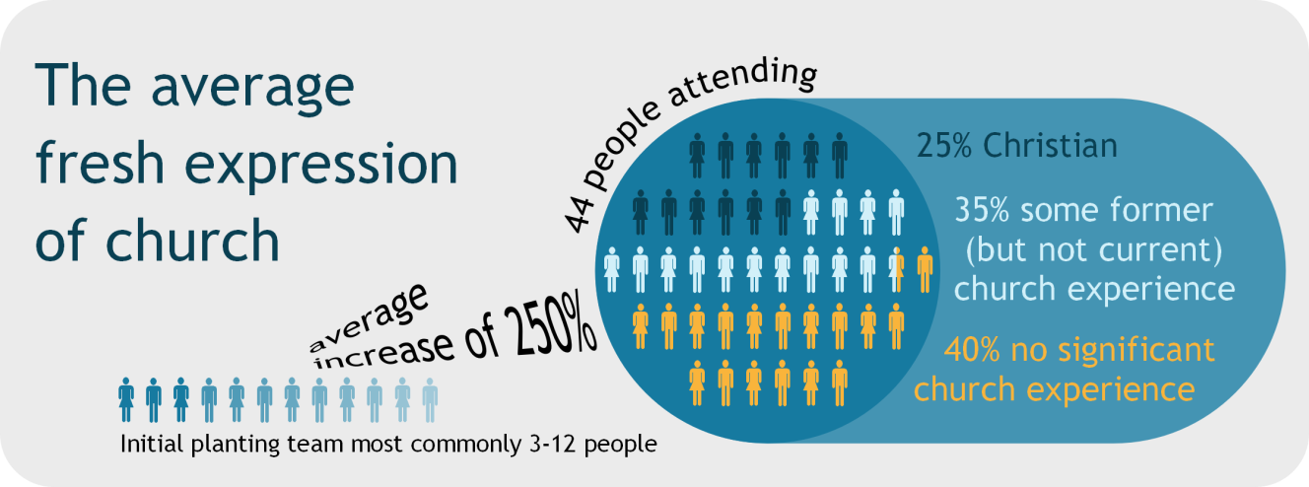
fresh expressions in the Church of England

Slide 27
fresh expressions in the Church of England

Slide 28
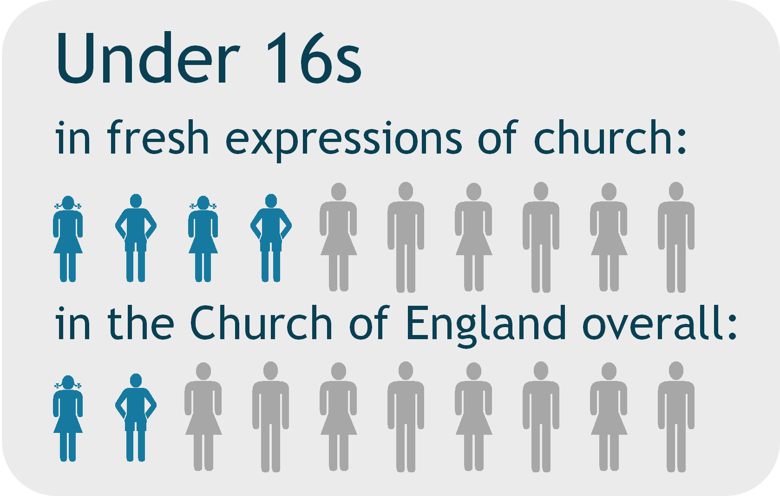
Fresh Expressions

Slide 29
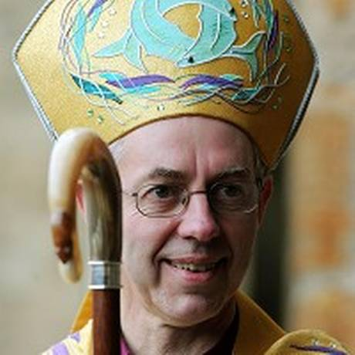
++Justin Welby
Fresh expressions and pioneer ministry are ways in which we say, how do we ensure that people find the grace and love of God, and see the treasure that there is in the gospel of Jesus Christ, in ways that they can find accessible?”
Fresh Expressions
26

Slide 30
following the missionary Spirit

Slide 31
contextual
mission
faith
discernment
diversity
living tradition
vocation
ecumenical
partnership
international
hope
following the missionary Spirit

Slide 32
Denominations and the Missional Church - UK Perspectives
+Graham Cray
Fresh Expressions
1

