Slide 1
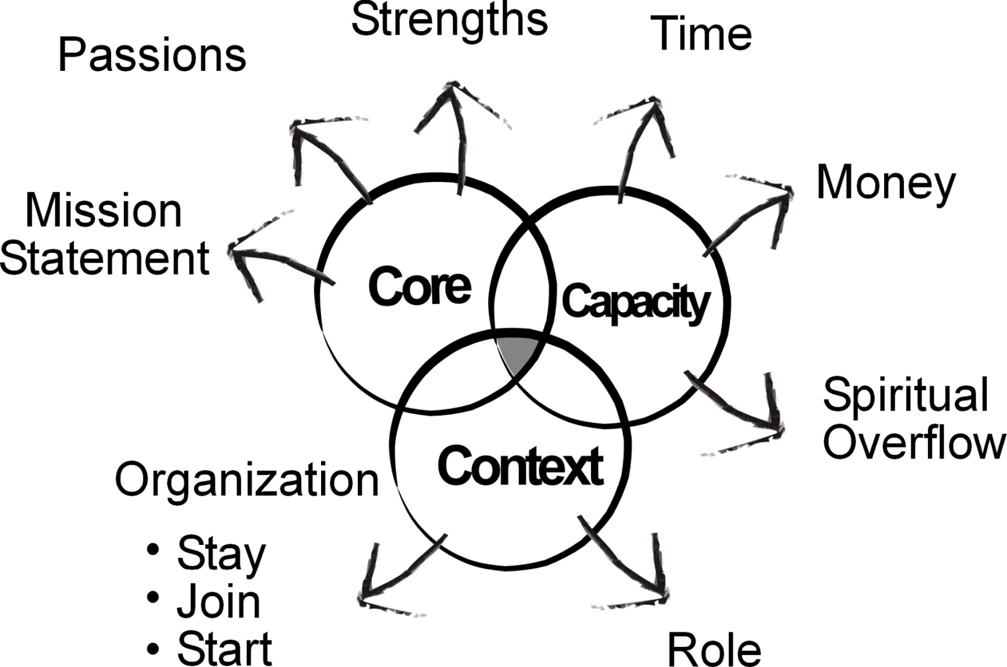
THREE ISSUES TO SOLVE

Slide 2
All serious daring
starts from within
your own identity.
– Eudora Welty
Notes:
Maar die heel grootste KEUSE wat ons het, is die keuse oor hoe ons ons identiteit verstaan.

Slide 3
Becoming a Trendsetter
Culture
Counter
Trendsetter
Notes:
Wanneer ons ons ware identiteit aanvaar, word ons ‘n “trendsetter”.
Dit beteken dat ons identiteit nie deur ons kultuur (wat ek doen, wat ek het, wat ander van my sê/dink) bepaal word nie, maar deur my ware identiteit in Christus – “I am the beloved”
Vanuit my ware identiteit is ek ‘n trendsetter wat ‘n kontra-kultuur begin om sodoende die heersende kultuur te verander.
Jesus is die beste voorbeeld hiervan.
Tommy se verhaal (video insetsel – John en sy ma).

Slide 4
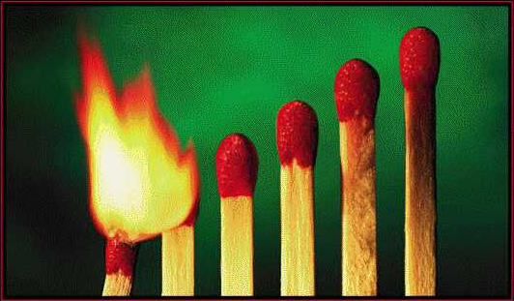
Igniting a life of
Adventure Joy Impact

Slide 6
Rich Papier
Stories
Cassie Carstens
Natasha form Ukraine
Rick Papier

Slide 7
Principals of Transformation

Slide 8
1. Wholistic
Always consider the
Physical, Economic, Emotional, Cognitive, Mental, Social, Spiritual aspects of individuals and the community

Slide 9
2. Development
It is VERY difficult (impossible?) for a person/community to commit to be empowered, and to engage in their own (and/or the community’s) development once they have been given a lot of things or have become dependent on whatever kind of relief.

Slide 10
3. Local Resources
Use of local resources (people and ”things”) especially at the beginning!

Slide 11
4. Local/Community Ownership
Build local/community ownership
Never, ever, ever make decisions “about” them, without them.

Slide 12
5. Multiplication
It is always better to expand/multiply both the vision (in others) and engaging others in the work.
It is always better in the long term if someone else has “the” idea and if someone else does the work, even if you could do it better/faster.

Slide 13
6. Long- term
Long-term perspective (vs short term)
Always think what is going to be best for the long term – even if a short-term gain is most desired

Slide 14
7. Prevention
Prevention (pro-active)
vs
Re-active
to disease or problems, challenges or situations .

Slide 15
8. Kingdom of God
It is about building God’s Kingdom,
not just ourselves/others, our community, our church, our denomination, our culture, our family.

Slide 16
Few thoughts about the beginning of Community Transformation

Slide 17
Be clear about the general or basic, “initial” idea/vision of community transformation (wholistic, community driven)

Slide 18
When communicating to anyone make sure they are clear about the vision (principles) you are casting and what you want them to do (if anything).

Slide 19
Have enough detail of vision that people can see, but not too much details that they feel that YOU have all the answers, that you have come up with “the plan” or everything figured out, or that the vision is “yours” and you just want them to get involved in it

Slide 20
Gather group/team of people that have differing perspectives so a wholistic perspective is achieved and maintained
(not just Christians or secular, or wealthy or poor, old or young, men or women…)

Slide 21
Communicate a sense of movement, that something (bigger than one person, group, organization…) is happening.

