Slide 1
Worship and/as Protest: The Relation Between the Liturgical and the Political
Missional worship Conference
Faculty of theology, Stellenbosch University
8 August 2019

Slide 2
Who is Your Workshop Leader?
Alease A. Brown
Born in Roosevelt, NY, USA
Poor/working class family of origin; first generation college
Degrees in African-American Studies, Law, Divinity
PhD in Systematic Theology from Stellenbosch, April 2019
Candidate for Ordination in the Methodist Church (UMC), formerly Evangelical (Spirit-filled) Non-Denominational Church member
Too Conservative and Too Liberal
Love Jesus & Scripture; late to political implications of the gospel
Intellectual Activism; NOT on-the-ground activism
She/Her Pronouns

Slide 3
Preliminary Matters
Reconsider the
Sacred/Secular distinction
Notes:
If it concerns:
Creation
God
Here, hereafter
It is matter of theology, and a matter for the church.
It is particularly fitting for the church to address all matters pertaining to human flourishing:
“I came that you might have life and have it to the full.” John 10:10
Have to reconsider the notion that church is only concerned with matters of soul salvation.
“Beloved, I pray that you would prosper and be in health, even as your soul prospers.” 3 John 2

Slide 4
Preliminary Matters
Jesus is ALWAYS on the side of the oppressed and marginalized

Slide 5
Preliminary Matters
JESUS IS ALWAYS ON THE SIDE OF THE OPPRESSED AND MARGINALIZED
Oppression and Marginalization is impossible to separate from race and gender.
Diff between theologies, e.g., liberation, Black, Womanist, Queer, Postcolonial, etc.
Notes:
Liberation would discuss class, economics—deny that race is an issue. Latin American context doesn’t emphasize this.
Black—says there is economic oppression, but it is a racialized economics.
Womanist—There is a three-fold oppression, race, class and gender
Queer, Postcolonial—Have to consider colonization’s impact on oppression, or sexuality’s impact on oppression, etc.

Slide 6
Preliminary Matters
JESUS IS ALWAYS ON THE SIDE OF THE OPPRESSED AND MARGINALIZED
There is a difference between the oppressed and the not-oppressed.
“We like to think… [that] individuals exist without their history. This is why we can draw false equivalences between the actions of white people and the actions of people of color, as if white people and people of color are not informed by and reacting to mammothly different experiences…[many cannot see that] perspectives come from different places because, to them, there is only one perspective, and it is white.
--Hari Ziyad
Notes:
Must appreciate that there are different points of view. The view from the bottom and the view from the top. And other different views besides those two.
We have to appreciate that these views are not the same.

Slide 7
Preliminary Matters
JESUS IS ALWAYS ON THE SIDE OF THE OPPRESSED AND MARGINALIZED
The Powerful want to control the terms of engagement.
Notes:
The powerful want to dictate when where how with whom, with what, and why people are allowed in the public square.
So the powerful say:
--if Jesus wants to walk through a field and eat the grain—You can’t do that
--If he wants to heal someone on the Sabbath—You can’t do that
--If he wants to talk to a woman at the well—you can’t do that
--If he wants to cast out a demon, he must be a demon—that’s not how we do things
--If he wants to raise someone from the dead—should not be done
The powerful want control of the terms of engagement in culture: what is allowed and what isn’t, what should and what shouldn’t be.
Jesus is on the side of the oppressed, not the powerful.
--When Jesus is trying to condemn, Jesus is on the side, ALWAYS, of the ones who are being condemned.

Slide 8
What Do Protesters Want?
Visibility.
Significance.
Acceptance.
Justice.
THE CHURCH EXCELS AT
IS CALLED TO
ADDRESS THESE CONCERNS
Notes:
Visibility. To be Heard, listened to
Significance. Want their situation and condition in the world to matter
Acceptance. Just as they are, with tattoos, piercings, t=shirts and baggy jeans, wild hair, language-they are the masters of this new media, and the language of this media is not Dad’s language; cussing is cool, totally acceptable and good,(bee-yatch, “I was high AF”); weed, dakka; queerness.
Justice. The things that are wrong, to be made right.
THE CHURCH (at its best, which it isn’t always) EXCELS AT IS CALLED TO ADDRESS THESE CONCERNS
Says, to people, God sees you. I see You. WE love you.
Says to people, you matter, your sould AND YOUR LIFE matter; the conditions of your life matter
Says to people, come as you are—God created you fearfully and wonderfully, Jesus loves you right now without you needing to change anything about yourself
Justice. Says to power, “What the people are saying is true! There is injustice. This cannot continue.” Ideally, Jesus’s model, is that HE leads the people in calling out injustice and does not wait for them to cry out against it.

Slide 9
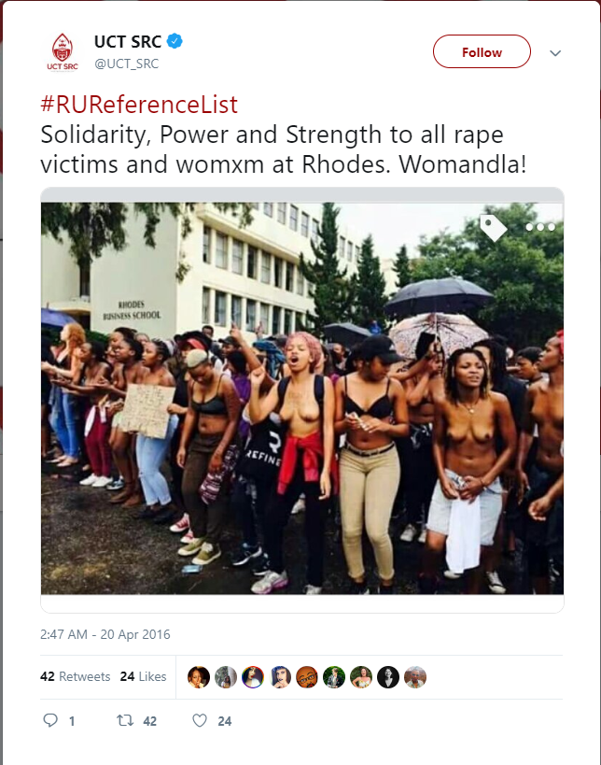
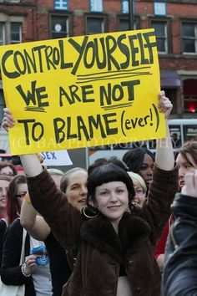
What Do Protesters Want?
HONOR & DIGNITY
THE CHURCH EXCELS AT-
IS CALLED TO-ADDRESS THIS
Notes:
Honor & Dignity
People are protesting who are living in contexts of extreme dishonor, disrespect, lack of dignity
Seeking DIGNity. Want DIGNITY recognized.
To the extent that it it being denied, see escalations of protest methods.

Slide 10
CHURCH/STREET SACRED/SECULAR LITURGIES
Church Liturgy and Liturgical Methods:
Bring Significance and Honor
Bring visibility to the Street
Bring legitimacy
Support, sanctuary, comfort
Notes:
Significance and honor—the street is the dishonored and oppressed; church as an institution has great power = honor and respect. By standing with those on the street, lend them the church’s honor. Like Jesus did for sinners.
Visability—Sometimes the church gains attention, bc of moral authority, which can be used to heighten SPIRITUAL and MORAL significance of an issue; not only political any longer, makes the claim a matter of faith, which implicates those who claim to be followers of Jesus.
Bring legitimacy—This claim is valid; Not by force of institutional power, but by showing alignment with scripture, tradition, symbols of the faith, etc.
Support, sanctuary, comfort—Food or water for protestors, safety for immigrants fleeing state forces, funeral for neighborhood victim

Slide 11
CHURCH/STREET SACRED/SECULAR LITURGIES
Street Liturgy and Liturgical Methods:
What are they?
Identify them; Name them
Notes:
What are they?
They are there. We have to see them, recognize them as liturgy,
Name them as such. The street does not use the language of liturgy. Power uses that language. Church must interpret for power the liturgical language of the street.
BTW, this is the work of a Black Public Theology of Liberation
Public Theology bc it is invites public participation, it is multidisciplinary, it speaks to issues of public and political concern.
Also, centers Black life, concerned with the task of full liberation for black persons (not mere alleviation of material conditions), hopefully of all genders.

Slide 12
Naming Street Liturgies:
Gathering of bodies—Aspects of Trinitarian incarnation
Notes:
Trinitarian Incarnation:
First, the gathering of bodies affirms the imago dei of humanity. When bodies gather in public places, particularly bodies that are raced as Black, their actions constitute an embodied insistence on being seen and on being recognized as human. The gathered pronounce their creation as beings bearing the image of God. Not only do they insist on recognition of their humanity, but their gathered presence presses their claim for recognition of a humanity that is free, and that is endowed with the rights of free persons; they claim nothing less than citizenship. Second, the gathered bodies image the church, the body of Christ, as a singularized plurality. The one body of Christ, the church, began with unheralded diversity for its day, Jews and Greeks, women and men, young and old, were afforded welcome. Bodies gathered in protest against injustice represent the same diversity and particularization of persons. Individuals, retaining their particularities, become homogenized into one unified body, which becomes church, through their common desire for God's peace, not the peace of the State, God's justice, not the Justice of the world. In gathering and assembling the individual bodies become the one body of Christ, through their modeling of Christ’s incarnation. By divesting themselves of the anonymity and safety that they could individually enjoy away from the assembly, the gathered demonstrate Jesus’ commitment to being bodily among those whom society regards as the least, and a . bodily commitment to the marginalized outpaces any loyalty to predominant cultures of accumulation and politics of inequality. In the pursuit of peace, justice, and solidarity, gathered protesting bodies can become sanctified bodies. The assembled bodies become the church.

Slide 13
Naming Street Liturgies:
Gathering of bodies—Aspects of Trinitarian incarnation
Notes:
Gathering Asserts the Potency of Spiritual Possibility
Third, the gathered bodies function as womb-like spaces that for a time remain unfilled. In these womb-spaces, that are assemblies of bodies, exist what has been described as “conditions of possibility.” Spaces where the transformative power of the Spirit is invited to appear and to occupy. These conditions of possibility, through the appearance of gathered bodies, are blank pages upon which the acts of the holy will be transcribed. Holy communion where law keeper and law transgressor encounter one another; where the bodies of the righteous might be broken, and the blood of the just might be shed. The spaces where bodies are gathered in protest are spaces in which those assembled are baptized into, and where they remember their baptisms into, a way that is narrow and a road that is hard, which leads to life. A way that only a few ever find. These conditions of possibility arising from the gathering of bodies allow opportunity for the disruptive work of the Spirit.

Slide 14
Naming Street Liturgies:
Gathering a performance of Trinitarian incarnation
Marked Bodies = Sacred Texts.
#Hashtaging as Confessional language
Notes:
Gathering Asserts the Potency of Spiritual Possibility
Third, the gathered bodies function as womb-like spaces that for a time remain unfilled. In these womb-spaces, that are assemblies of bodies, exist what has been described as “conditions of possibility.” Spaces where the transformative power of the Spirit is invited to appear and to occupy. These conditions of possibility, through the appearance of gathered bodies, are blank pages upon which the acts of the holy will be transcribed. Holy communion where law keeper and law transgressor encounter one another; where the bodies of the righteous might be broken, and the blood of the just might be shed. The spaces where bodies are gathered in protest are spaces in which those assembled are baptized into, and where they remember their baptisms into, a way that is narrow and a road that is hard, which leads to life. A way that only a few ever find. These conditions of possibility arising from the gathering of bodies allow opportunity for the disruptive work of the Spirit.

Slide 15
WHAT ABOUT VIOLENCE?
How Do We Engage With Protest that Escalates into the Use of Physical Force?
Notes:
Cone regards Malcolm X as the most trenchant race critic in American history.
Cone initially regarded X as a racist. As the Civil Rights movement progressed, Cone’s opinion changed. X helped Cone understand white racism, black rage, and “Black Power.”
Cone’s thinking was shaped by X. In his words:
“No one analyzed the role of Christianity and its mental and material consequences upon the lives of Blacks as Malcolm did.” (J. Cone 2000, xx–xxi)”

Slide 16
WHAT IS VIOLENCE?
Complicate MEANING of the term violence
Structural violence
Cultural violence
Physical violence
Notes:
Complicate use of the term violence
Structural violence—imbedded in systems—like townships existence
Cultural violence—like language, aesthetics. Change moral color to bad/good—like Apartheid. Segregation is good.
Physical violence—use of force
Powerful want to control the terms of engagement. Want us to consider that only one of these things is violence; and also that violence is BAD.

Slide 17
USURP THE TERMS OF ENGAGEMENT
Complicate USE of the term violence
Jesus and taxes
Question of should violence be allowed; not the right question for the church to engage.
Notes:
Complicate USE of the term violence
Jesus and taxes—flipped the question on the questioners
Question of should violence be allowed; not the right question for the church to engage.
God is on the side of the (Black) oppressed. Period.
The question must be changed. Not the violence of the protestors that merits discussion but the violence done to the protestors.
Jesus and the tax issue—the issue is not what your duty to God means with respect to what you owe to Caesar. The question is what is your duty to God means with respect to what you owe to God.
Jesus shifts the terms of the conversation, and this is what we want to do.
But we must use wisdom with this, bc you do not want to incite escalation of protest and the use of force; you don’t want to incite destruction, but you also cannot condemn it if God is on the side of the oppressed protestor, and you are on the side of God.

Slide 18
WHAT ABOUT NON-VIOLENCE?
Isn’t the Use of Force Bad? Isn’t Non-violence the Christian way?
Discourse of the powerful
Violence is neutral
Notes:
But Isn’t the Use of Force Bad? Isn’t Non-violence the Christian way?
Discourse of the powerful—Remember those in power control the ideas that we have about what is right and wrong. Not the powerless. The powerful do not even recognize their own violence to the oppressed, much less call it bad or wrong.
Physical Violence is neutral.
Bullying abusive physical beating. Bad. Force to stop the abuse, Good.
Good use of force countering a bad use of force.
Like the holocaust example.
Like fire, like sex, aggressive physical force is neutral.
All have the potential to do great good, but also the potential to do great harm.
Must handle the use of force carefully.

Slide 19
PHYSICAL VIOLENCE AS LITURGY
Fanon talks about the value of violence as a cleansing act, restorative of agency.
Girard talks about the necessity of violent scapegoating for the operation of society
I myself have a theory of the Will that the extinguished will can be resurrected; and that the use of force is evidence of the revitalization of the will.
Maybe
Spirit
Notes:
Spirit—
If you are there, the space is a place of possibility for the Spirit to move.
You might be there and become a martyr-like innocent religious figure who is injured and brings awareness to the cause
You might rush around and help other victims who are hurt or injured and get them to a place of safety
Or, you might see police beating a defenseless person and rush forward into the aggression.
We don’t know. We can’t know. Until we are in the situation, and then we have to act in accordance to how we are moved to act.
Not arriving with the expectation that physical force is going to be used; go in with the opposite goal and hope; but then these things have energy that must be respected.
BUT again, let me repeat, that I am not a street activist, I am a theorist.

